Slide 1

Michigan Real Estate Predictor Models
Justin Clawson
Joel Fisher
Cole O’Neill
Selena Passeno
Zac Williams

Slide 2








Tools Used

Slide 3

PROJECT OVERVIEW
PROJECT DESCRIPTION
We used housing market data to try to predict the sale price of houses in Michigan based on factors like square footage, location, bedrooms and bathrooms, lot size, and zip code.
DATA SOURCE
Downloaded from Kaggle
USA Real Estate Dataset
Realtor.com
ETL PROCESS
Downloaded data, cleaned to include Michigan only
Drop duplicates and unneeded fields
Loaded to Spark SQL database

Slide 4
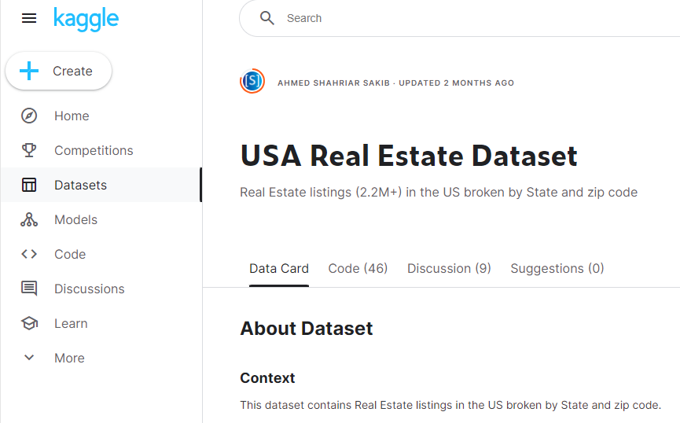
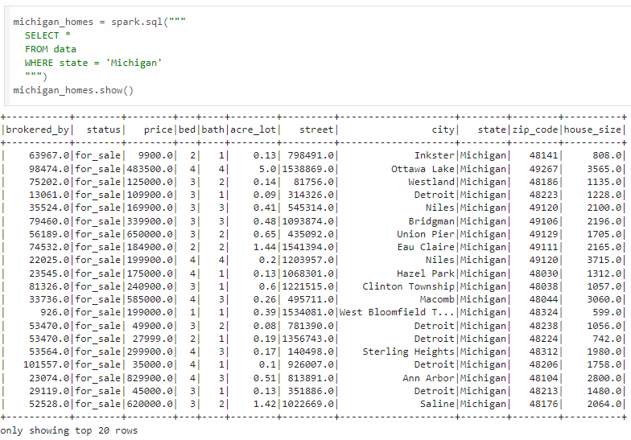

ETL Process

Slide 5
THE CLEANED DATA
How much data are we working with?
Original data = 1,084,909 rows, 12 columns
Cleaned (MI only) data = 22,076 rows, 11 columns
Removed previously sold date, duplicates
Fun facts
404 square miles worth of property up for sale in Michigan!
ZIP with highest avg price is 49115 at $2.6M – along 94 just north of IN border
Just over $7B in real estate total
Other tidbits
Average house size 1,880 sq. ft., median 1,584.
Average price about $318,000, median price $210,000.

Slide 6

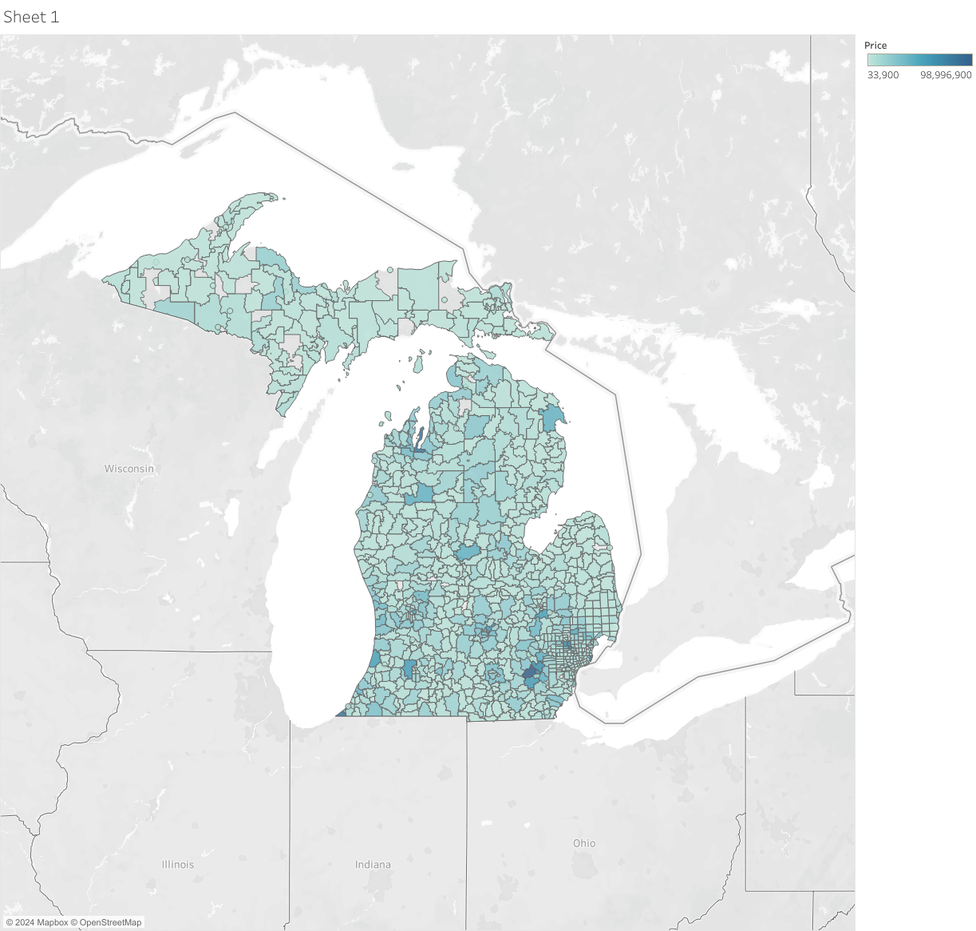
VISUALIZATION
Darker green = higher price
Grey counties = no data
Highest prices seen in the Ann Arbor area

Slide 7
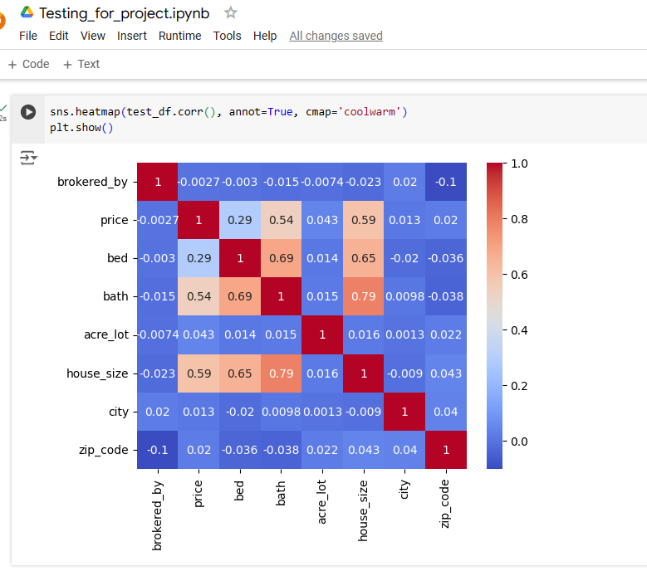
This code shows us the correlation between all variables in the data
Correlation Heatmap
Gives us an idea of what variables will be the most successful in models
You expect high correlation between size and bed/bath

Slide 8
Models
LINEAR REGRESSION
We used a linear regression model to predict price with zip code, bed, bath, acreage, and house size
DECISION TREE
NEURAL NETWORK
RANDOM FOREST

Slide 9
LINEAR REGRESSION MODEL

Slide 10
DECISION TREE MODEL

Slide 11
NEURAL NETWORK MODEL

Slide 12
RANDOM FOREST MODEL

Slide 13
MODEL RESULTS compare model results here Identify the best model

Slide 14
Here give more details about the best model and related visualizations We used multiple iterations and did our best to optimize each model
The best model

Slide 15




PROJECT CONCLUSIONS
BEST MODEL
What was the best model and why?
WHAT WE LEARNED
What did this model tell us?
OTHER CONSIDERATIONS
What else could we have done with more/better data?
01
02
03

Slide 16
Thank You

